Slide 1
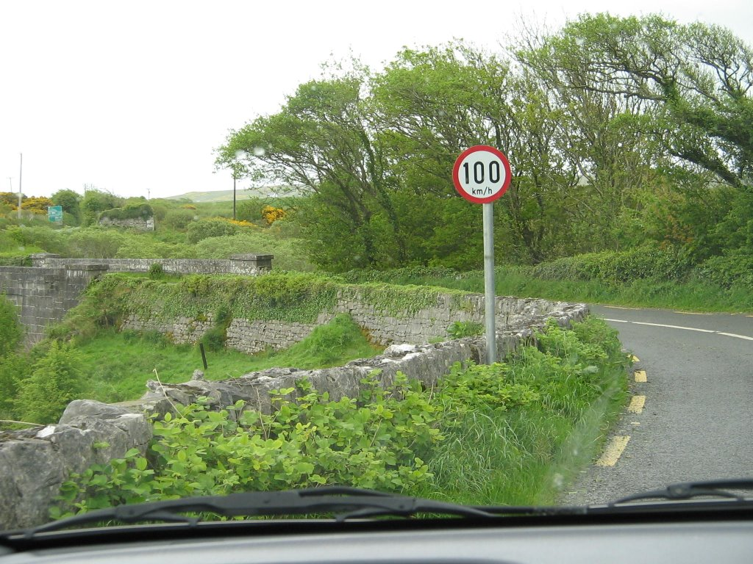
Street Sign Detector Identifying Street signs on Irish roads
Image Processing gROUP pROJECT
Declan THorne - c1742592
Philip Toolan - c17433026
CONOR MONAHAN - c16475956

Slide 2
THE PROJECT PROBLEM
Implementation
Conclusion

Slide 3

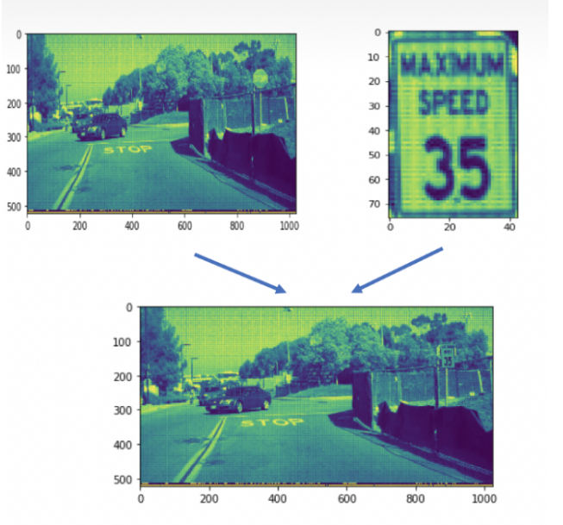
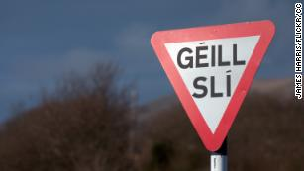
The Project Problem
Irish Road Sign Identification
Speed Signs & Yield
An original idea
Potential uses
Assist drivers
Automatic driving systems,
Detecting & recognizing signs effectively

Slide 4







Proposal Stage
Brainstormed ideas individually
Worked out which ideas were good
Got the all clear
Planning Stage
Research
Development Plan
Papers (Scholars, Web)
Implementation
Testing (test images etc.)
Development of methods
Evaluation and reflection (effective/daily grind)
OpenCV Documentation

Slide 5
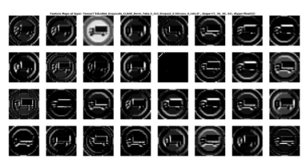
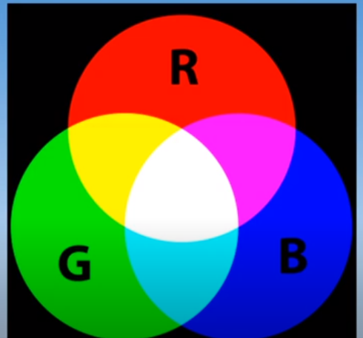
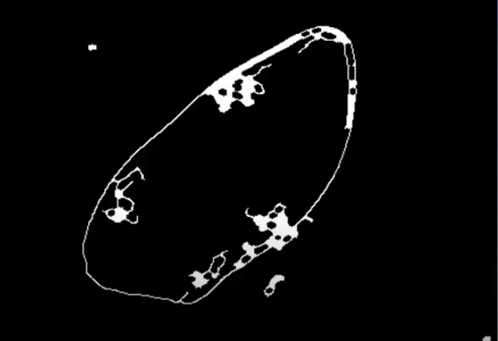
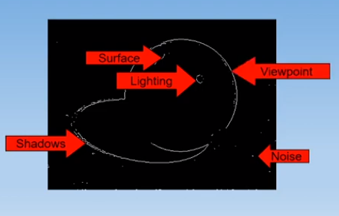
Research
We researched articles & previous methods used
How could we 'detect' street signs?
Shapes
Colours
What methods could we use?
Image Basics
Transformation
Segmentation
Features

Slide 6

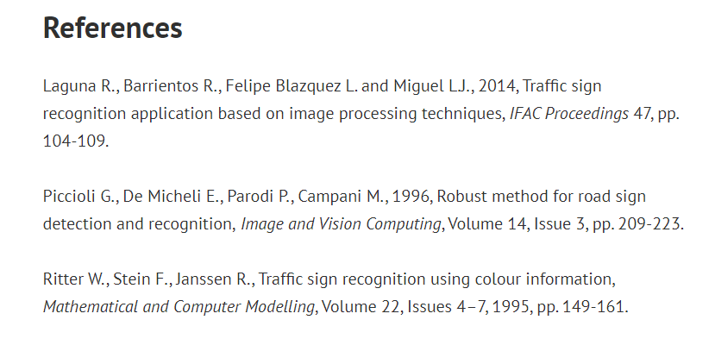
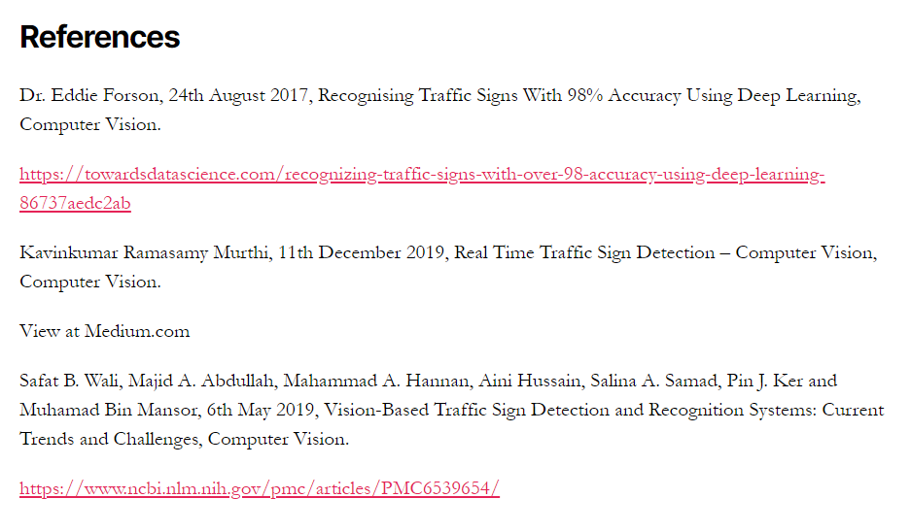
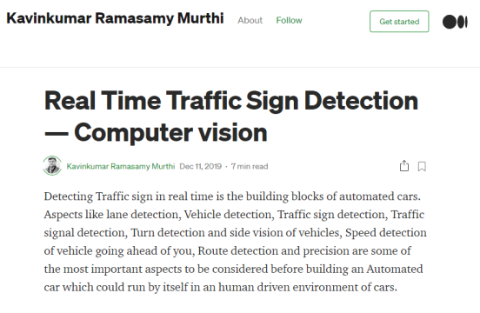
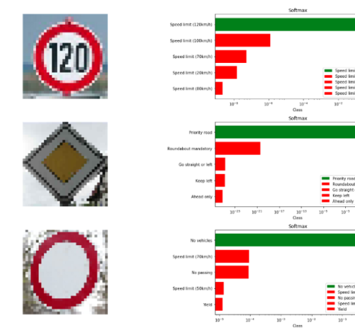


Slide 7
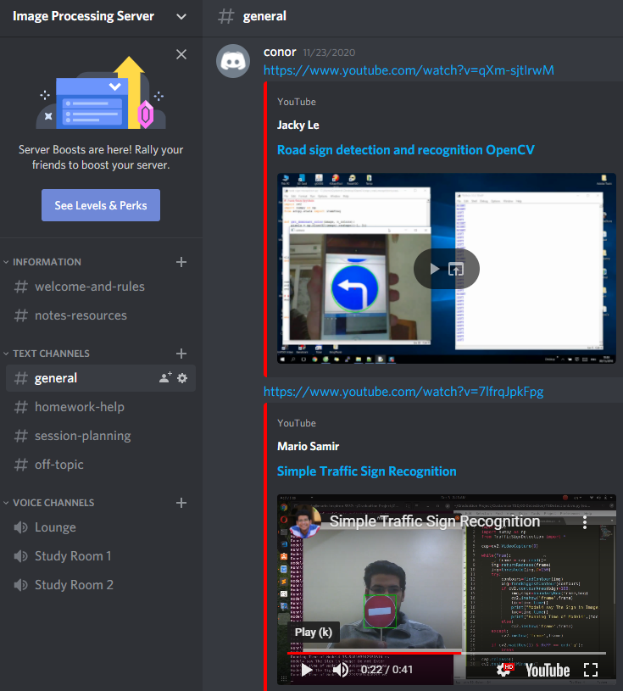
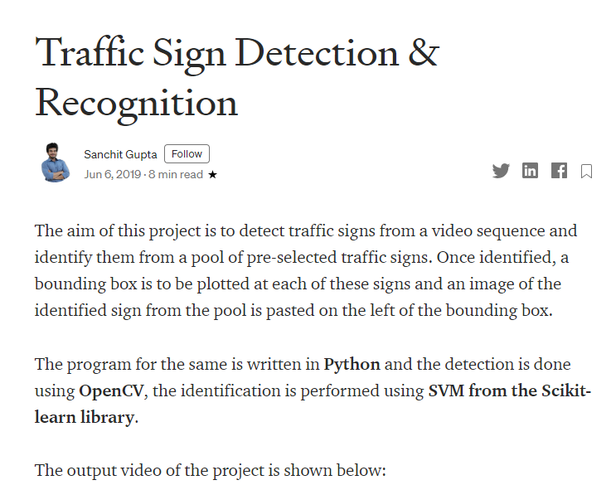
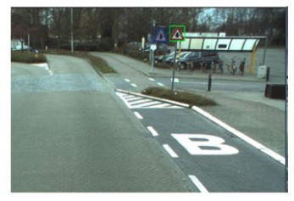

Slide 8
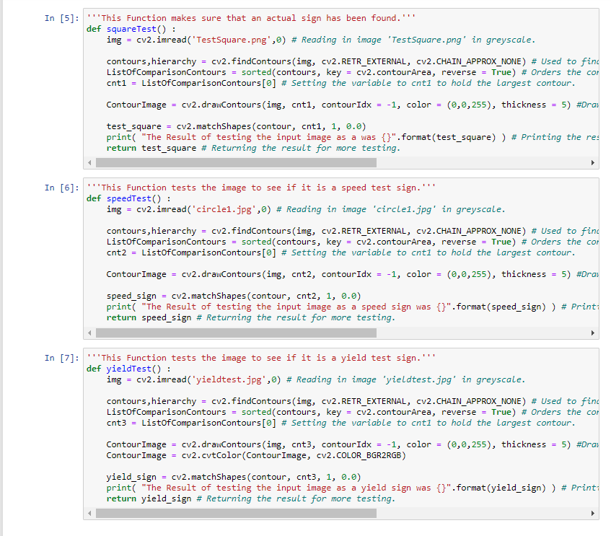

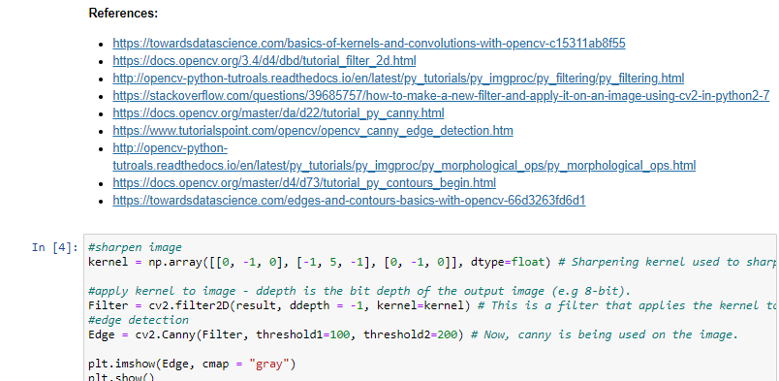
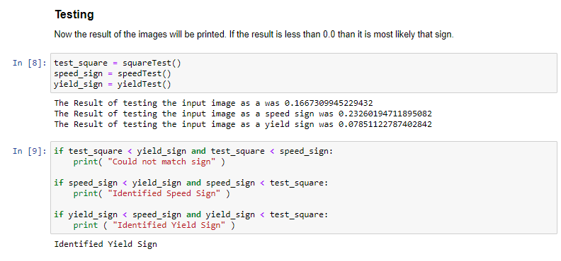
Implementation
Segmentation
Identify and isolate the street sign
Segmenting by colour
Equalization & masking
Edge Detection
Sharpen the image
Dilate
Draw contours
Matching

Slide 9
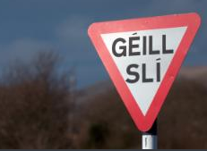





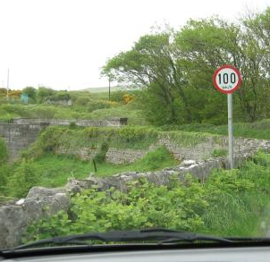

Slide 10

Image Processing Project Final thoughts
Notes:
Benefits
- Solve problems together and broaden your thinking.
- Helping each take advantage of their own strengths
Challenges
- Online communication

Slide 11


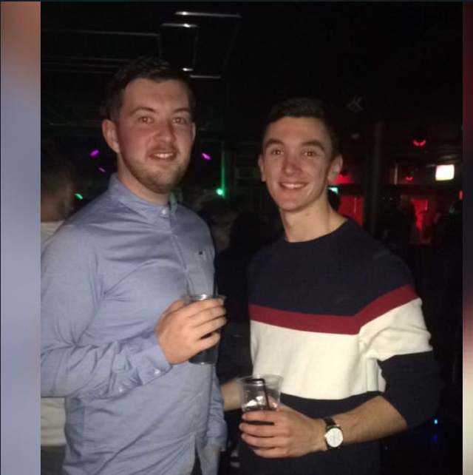

Thank you for your time!

